Slide 1

Plant Leaf Classification
Group 9
Kapil Sharma
Harshavardhan Reddy Ramireddy
Jinal Patel
Alankrit Verma
CS5542 – Big Data Analytics and Application - Project Presentation

Slide 2

Content
Introduction
Overcoming Challenges
Background and Related Works
Architecture and Methodology
Data, Code Snippet, and Results
Conclusion
Q & A

Slide 3
Introduction
There are estimated to be nearly half a million species of plant in the world. Classification of species has been historically problematic and often results in duplicate identifications. Automating plant recognition might have many applications, including:
Species population tracking and preservation
Plant-based medicinal research
Crop and food supply management.
Objective: To use binary leaf images to identify 99 species of plants via Machine Learning (ML) methods. Three sets of pre-extracted features are provided, including shape, margin and texture.
Implement multiple machine learning models and compare results

Slide 4
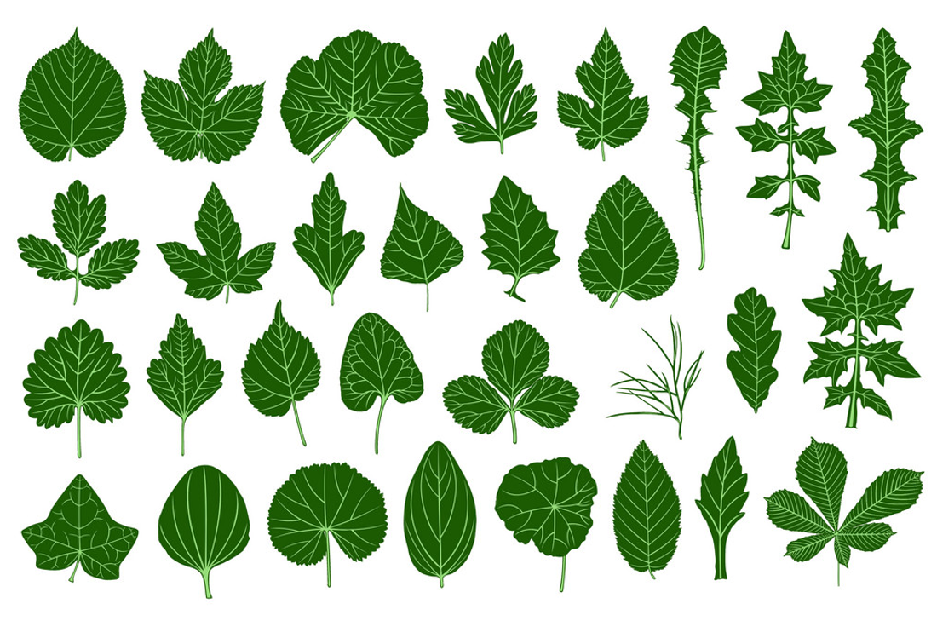

Overcoming Challenges

Slide 5
Background
Following Machine learning methods have been implemented and compared:
Random Forest
Decision Tree
k-nearest neighbors (k-NN)
Convolution Neural Network (CNN)
Support Vector Machine (SVM)
XGB
Stacking

Slide 6
Related Works
“Leaf Classification for Plant Identification Using Deep Learning” by : Ali Beikmohammadi, Karim Faez
“Plant Leaf Classification using Probabilistic Integration of Shape, Texture and Margin Features by Charles Mallah, James Cope, James Orwell
“Plant leaf classification using multiple descriptors: A hierarchical approach” by Jyotismita Chaki, Ranjan Parekh, Samar Bhattacharya
“Leaf Recognition Using Machine Learning” by: Redha Ali, Russell Hardie, Almabrok Essa
“Plant leaf classification using dual path convolutional neural networks” by SARA RIZK
“Plant leaf classification using GIST texture features” by Fateme Mostajer Kheirkhah1 , Habibollah Asghari1

Slide 7
Architecture and Methodology
Input Data
Data Preprocessing
Multi Classifier models
Model Training
Model Evaluation
Model Result Comparison

Slide 8
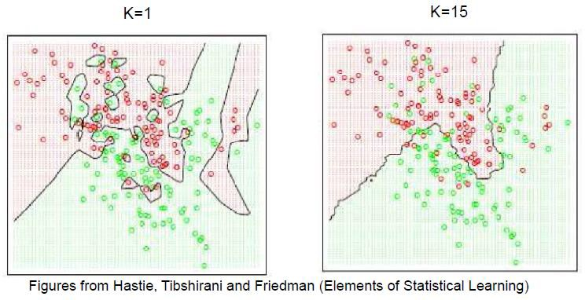
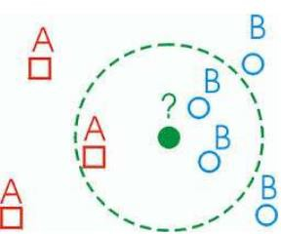
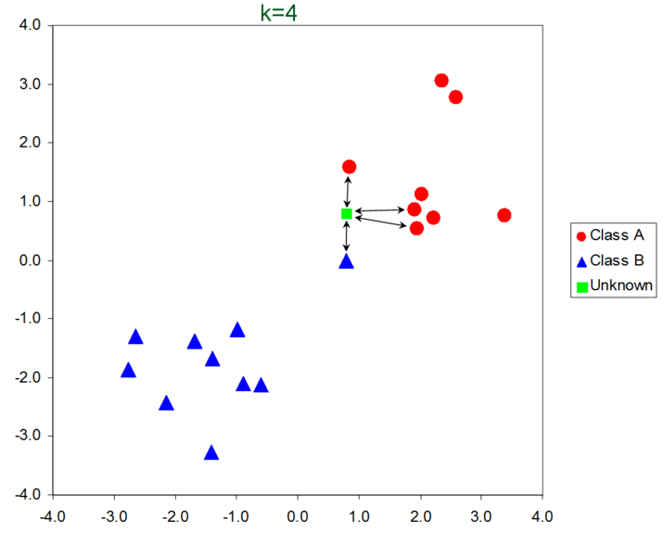
KNN Classification
Classified by “MAJORITY VOTES” for its neighbor classes
Assigned to the most common class amongst its K- nearest neighbors (by measuring “distant” between data)

Slide 9
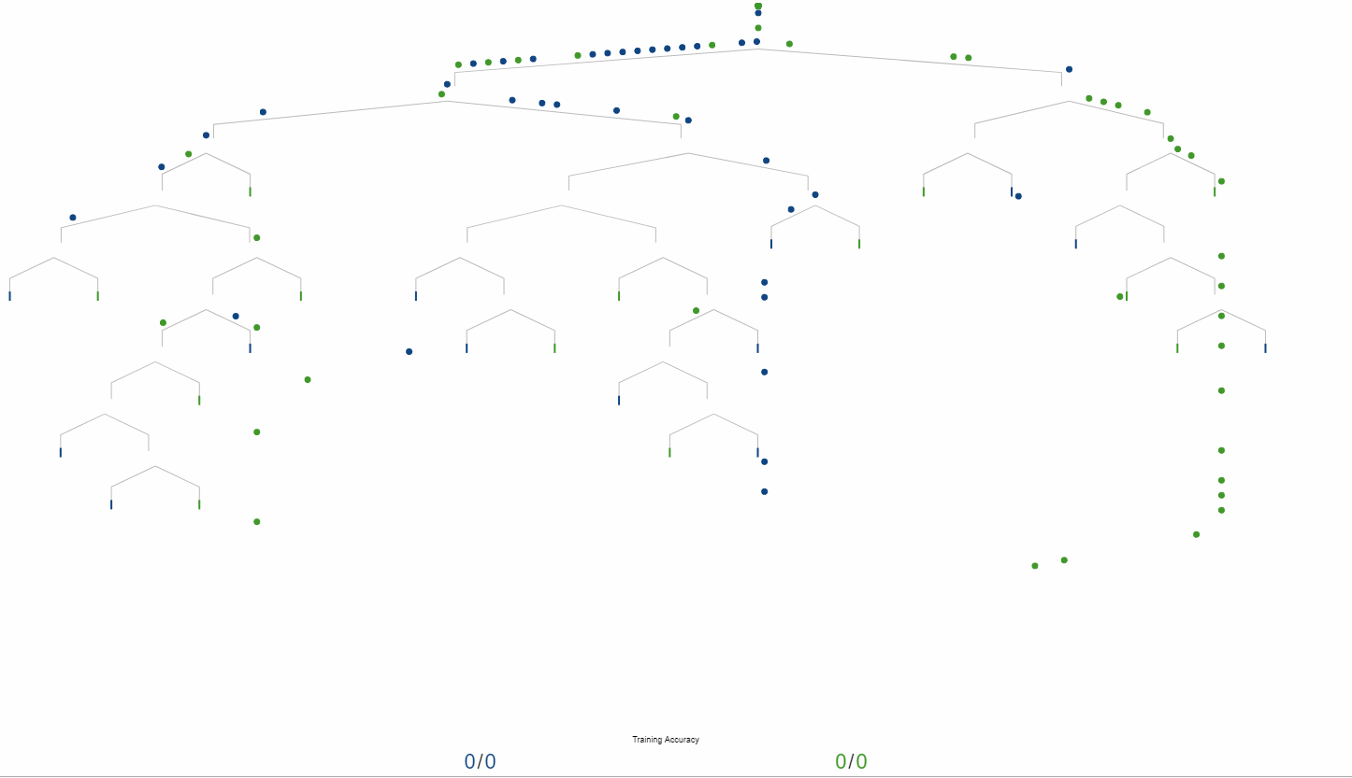
Decision Tree
A decision tree leads you to a prediction by asking a series of questions on whether you belong to certain groups (see below Figure). Each question must only have 2 possible responses, such as “yes” versus “no”. You start at the top question, called the root node, then move through the tree branches according to which groups you belong to, until you reach a leaf node. The proportion of survivors at that leaf node would be your predicted chance of survival.

Slide 10
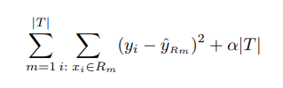
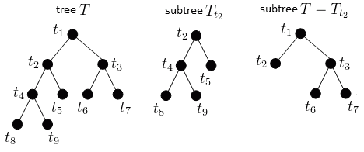
Decision Tree – Pruning
Use recursive binary splitting to grow a large tree on the training data, stopping only when each terminal node has fewer than some minimum number of observations.
Apply cost complexity pruning to the large tree in order to obtain a sequence of best subtrees, as a function of α.
Use K-fold cross-validation to choose α. That is, divide the training observations into K folds. For each k = 1,...,K: (a) Repeat Steps 1 and 2 on all but the kth fold of the training data. (b) Evaluate the mean squared prediction error on the data in the left-out kth fold, as a function of α. Average the results for each value of α, and pick α to minimize the average error.
Return the subtree from Step 2 that corresponds to the chosen value of α.

Slide 11
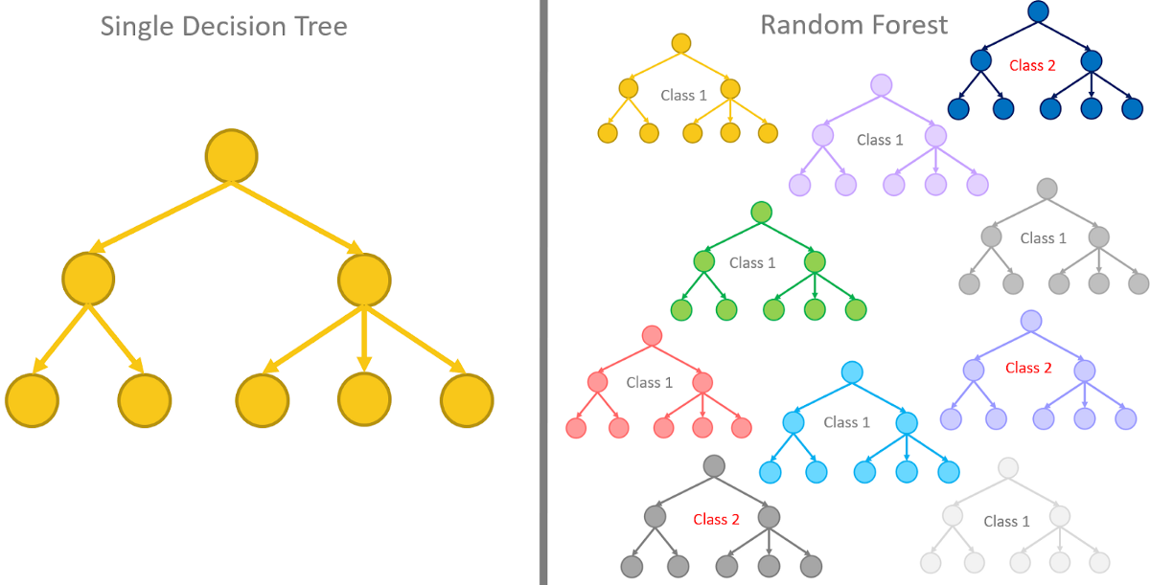
Random Forest
Random Forest is a tree-based machine learning algorithm that leverages the power of multiple decision trees for making decisions. As the name suggests, it is a “forest” of trees!
But why do we call it a “random” forest? That’s because it is a forest of randomly created decision trees. Each node in the decision tree works on a random subset of features to calculate the output. The random forest then combines the output of individual decision trees to generate the final output.
In simple words:
The Random Forest Algorithm combines the output of multiple (randomly created) Decision Trees to generate the final output.

Slide 12
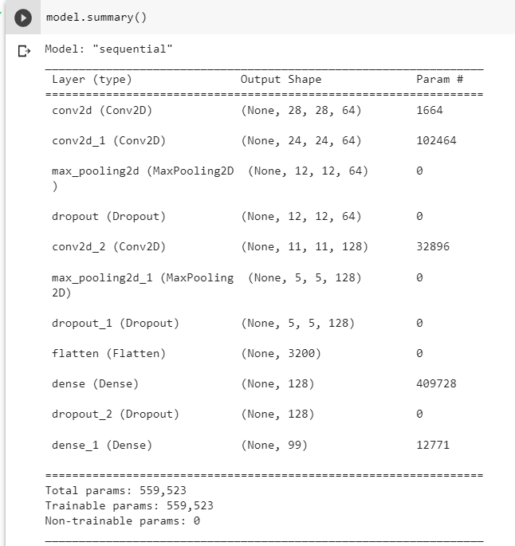
CNN
Input Data
(Age, Gender, Ethnicity, Image)
Data Preprocessing
Unified Model
Model Training
Model Evaluation
Validation or Prediction

Slide 13
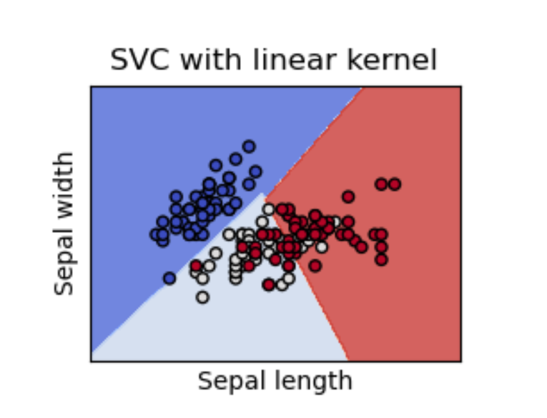
Support Vector Classifier
The objective of a Linear SVC (Support Vector Classifier) is to fit to the data you provide, returning a "best fit" hyperplane that divides, or categorizes, your data. From there, after getting the hyperplane, you can then feed some features to your classifier to see what the "predicted" class is.

Slide 14
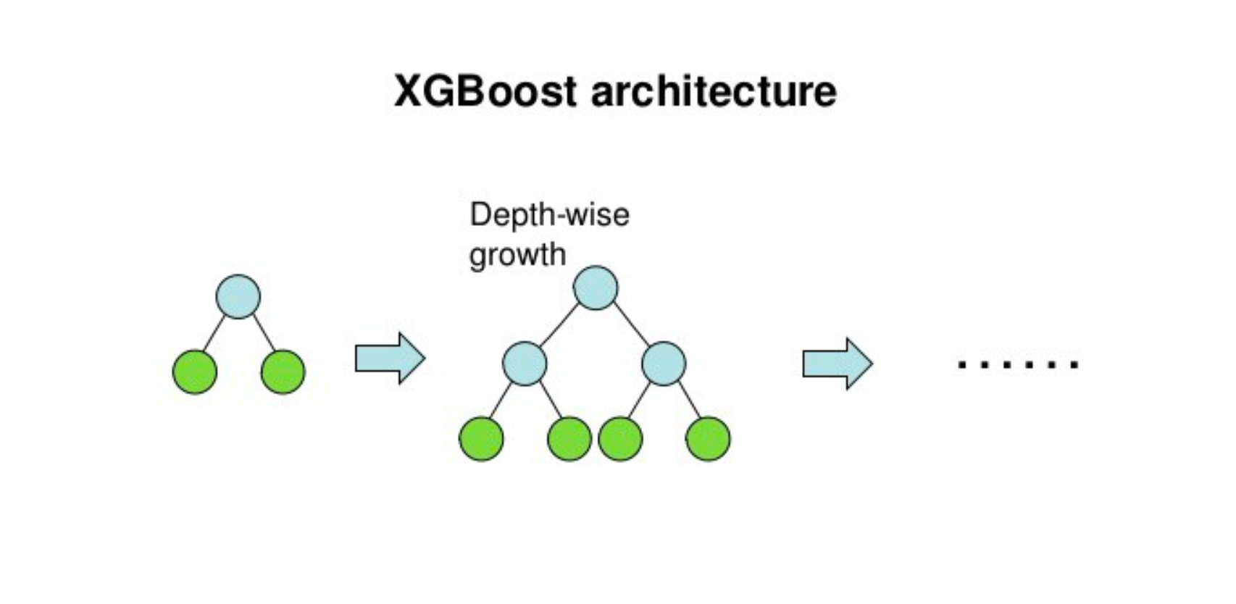
XGBoost
XGBoost is an optimized distributed gradient boosting library designed to be highly efficient, flexible and portable. It implements machine learning algorithms under the Gradient Boosting framework.

Slide 15
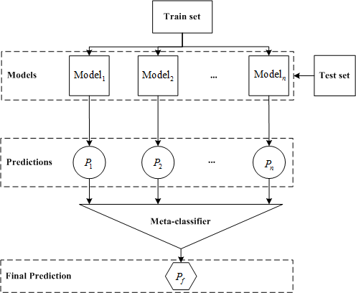
Stacking Classifier
Stacking Classifier is a Stack of estimators with a final classifier. The base learner models are stacked together and the predictions of these base learners will be fed into a final classifier or a Meta Classifier that gives the final predictions with a scope for improving the overall individual model performances.

Slide 16
Data
1584 Leaf Specimens
16 Samples of 99 Leaf Species.
Classifications
The leaves are classified into 99 species
Data fields
id - an anonymous id unique to an image
margin_1, margin_2, margin_3, ..., margin_64 - each of the 64 attribute vectors for the margin feature
shape_1, shape_2, shape_3, ..., shape_64 - each of the 64 attribute vectors for the shape feature
texture_1, texture_2, texture_3, ..., texture_64 - each of the 64 attribute vectors for the texture feature

Slide 17
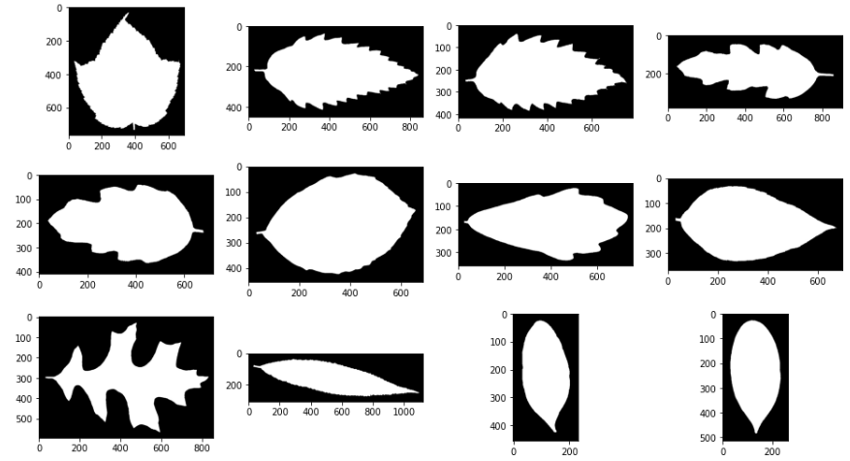
Images Preview

Slide 18
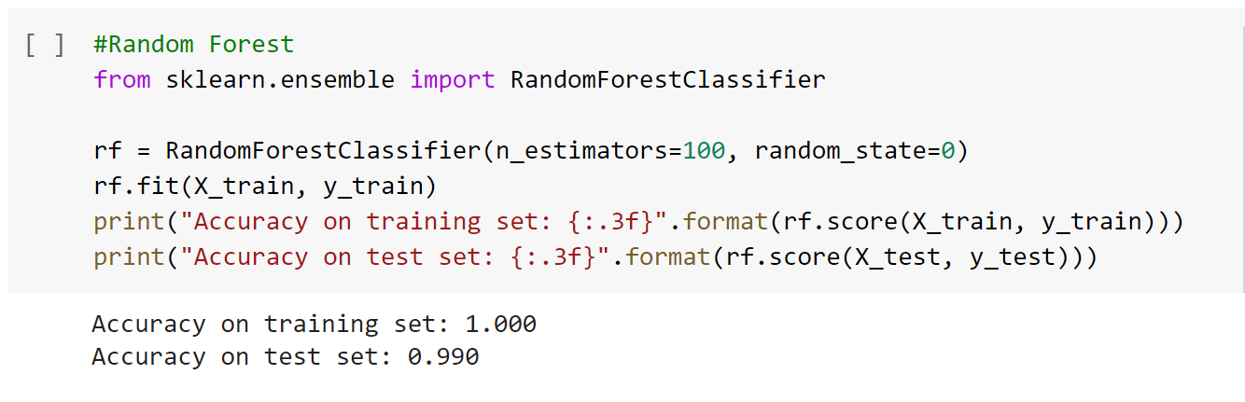
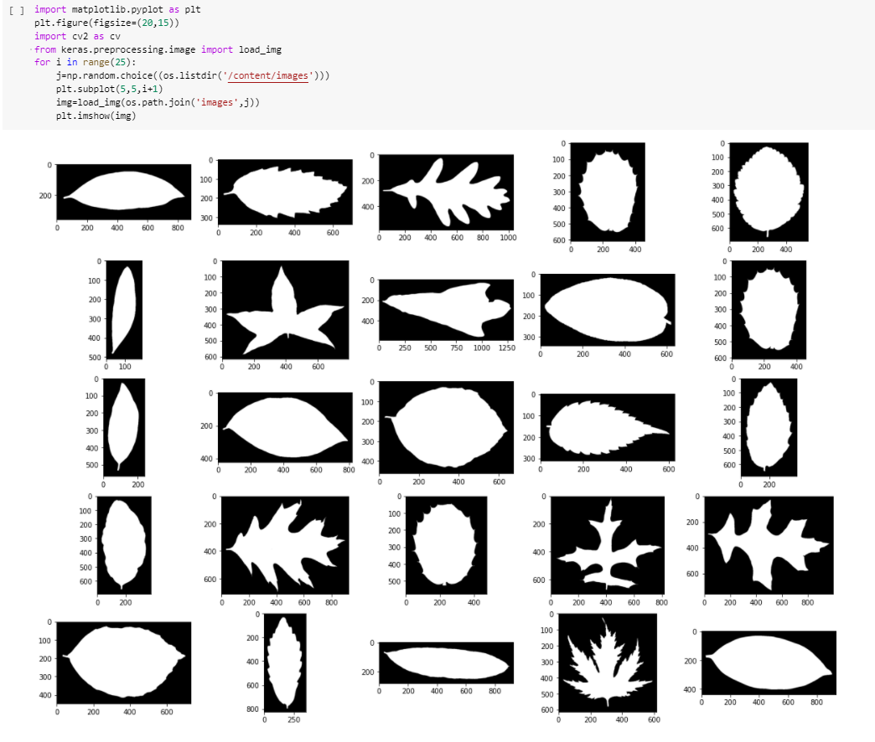
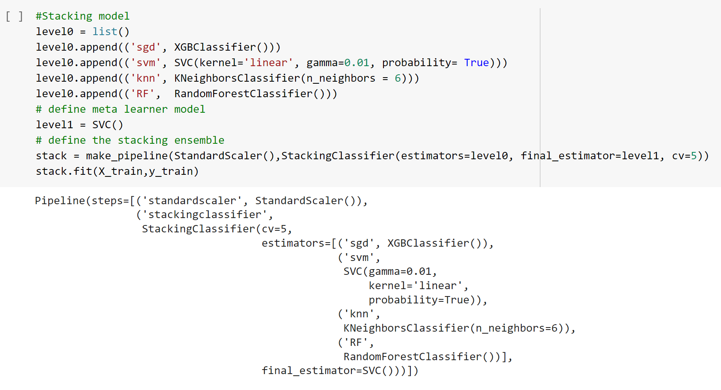
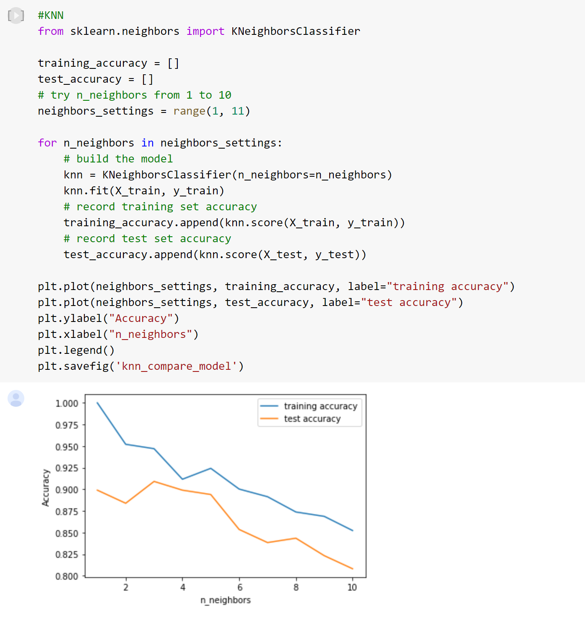
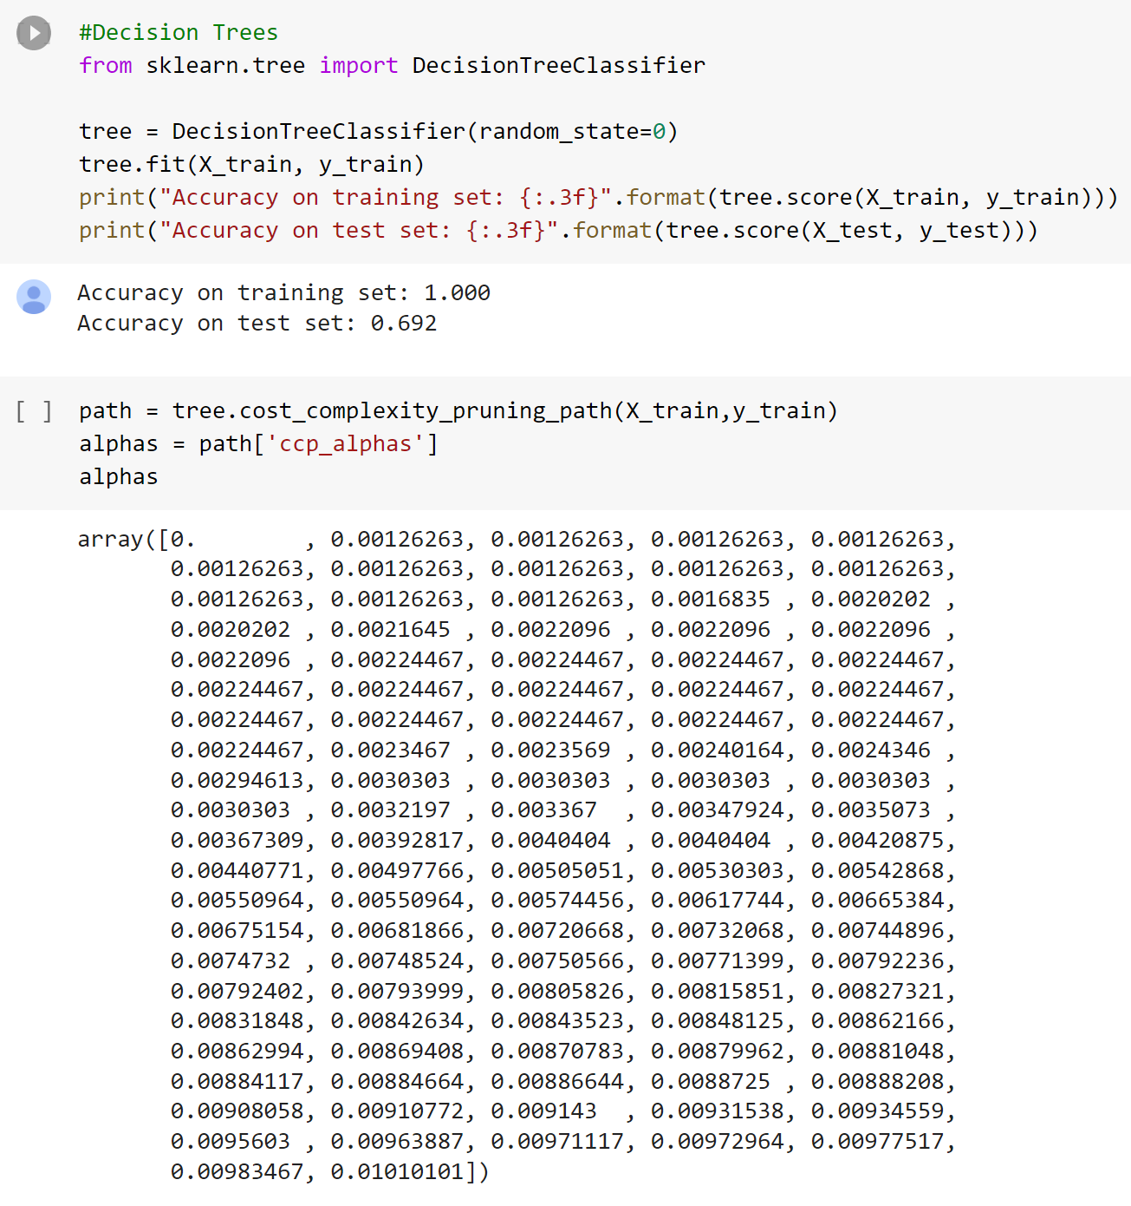
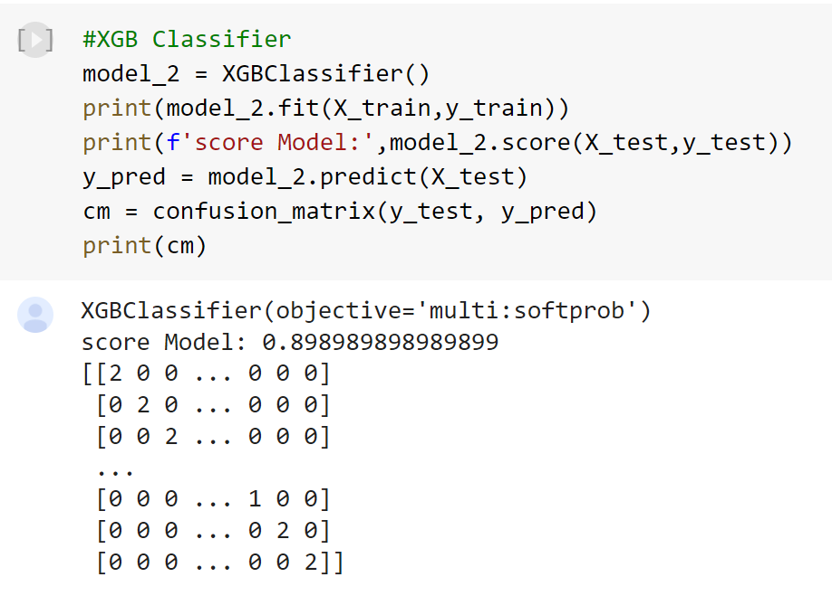
Code Snippets

Slide 19
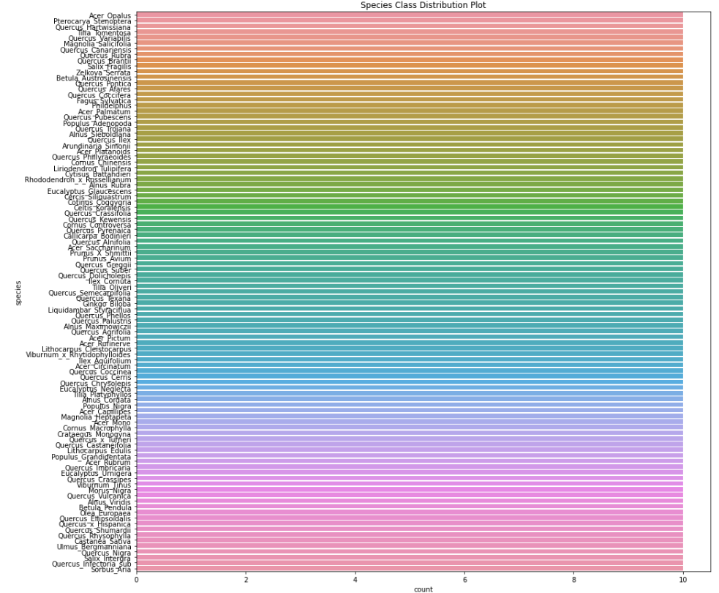
Class Distribution

Slide 20
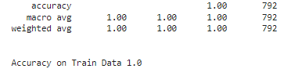
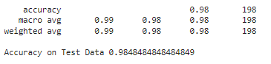
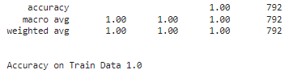
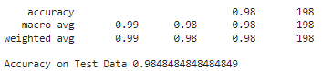
Results
Logistic Regression:
Train Results: Test Results:
Support Vector Machine(SVC):
Train Results: Test Results:

Slide 21
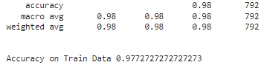
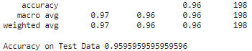
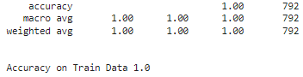
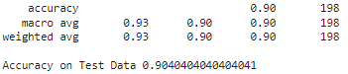
Results
K-Nearest Neighbors:
Train Results: Test Results:
XGBoost Classifier:
Train Results: Test Results:

Slide 22
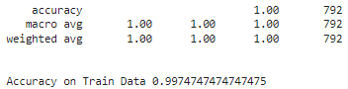
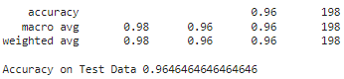
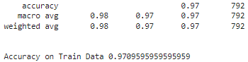
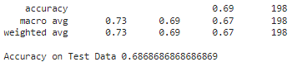
Results
Random Forests:
Train Results: Test Results:
Decision Trees:
Train Results: Test Results:

Slide 23
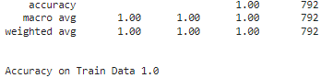
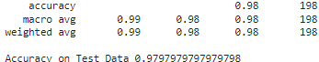
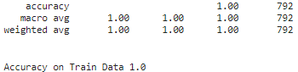
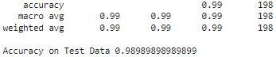
Results
Stacking Classifier:
Train Results: Test Results:
LDA:
Train Results: Test Results:

Slide 24
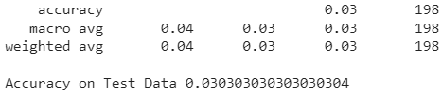
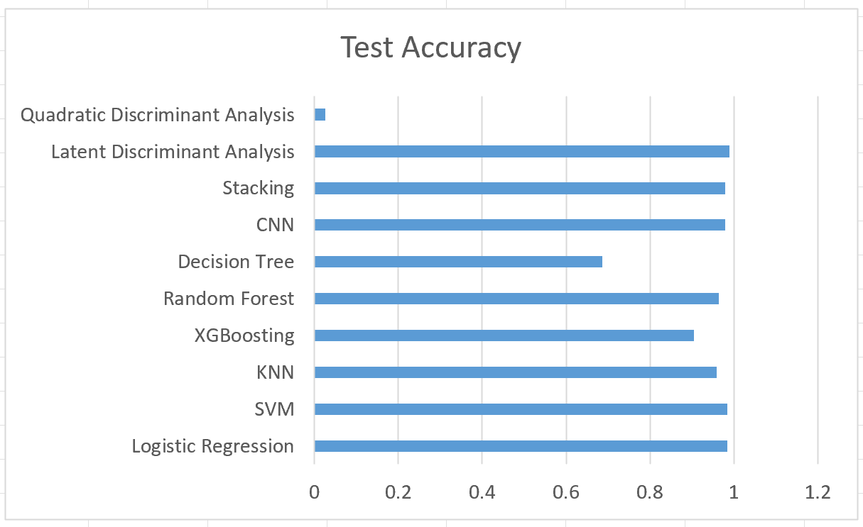
Results
QDA:
Train Results: Test Results:
Comparison of all Model Accuracies:
From the Results, We can see that the below mentioned models are the best performing models comparatively.
Latent Discriminant Analysis
Logistic Regression
SVM
CNN

Slide 25
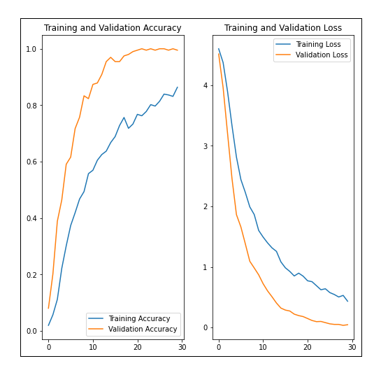
Results
CNN:
Train and Validation Accuracy: Train and Validation Loss:

Slide 26
Challenges
Implementing CNN was challenging due to images were not labeled as the labels were stored in separate csv file
The training of the CNN model has taken longer because of limited access to the GPU and resource limitations.
Working with various classification models was a bit challenging as there was no prior experience of using most of the implemented machine learning models. But, it helped us gain knowledge and experience of using these models.
We were able to extract limited no. of features from the images as the images are in grayscale.

Slide 27
Conclusions and Future Outlook
Successful implementation of a multi-layered CNN, Support Vector Machines, Logistic Regression, Ensemble Models(Random Forest, Decision Trees, XGBoosting, Stacking) to identify leaf species.
Compared multiple Model Performances and determined from the results that Latent Discriminant Analysis, Logistic Regression, SVM and CNN models performed well.
In the future there is a plausibility of feeding the networks with regular colored images instead of preprocessed monochrome input images.
Future area for enhancements would be determining the anomalies and abnormalities in the leaf based on the image.
Species population tracking and preservation, Plant-based medicinal research, Crop and food supply management are few noted applications.
Expand the dataset and improve the model to improve predictions on noisy images as well.
Explore state-of-the-art methods to detect and locate leaves from the background.

Slide 28
Q & A

Slide 29
THANK YOU

